Slide 1

Napredno softversko inženjerstvo MAS – RII – SI
Stamenović Jefimija 1820/2024

Slide 2
Sadržaj
1
2
3
4
5
6
Motivacija
Korišćene tehnologije
Arhitektura aplikacije
Pokretanje aplikacije
Dokumentacija
Slojevi i modeli

Slide 3
1
Motivacija

Slide 4
Šta je FastAPI?
Moderan i brz Python framework
Podrška za savremeni razvoj API-ja
Razvoj baziran na standardnim specifikacijama
ASGI standard

Slide 5
Koji problemi se rešavaju
Ručna validacija podataka
Nedostatak dokumentacije
Paralelna obrada podataka
Nedostatak kontrole nad strukture podataka

Slide 6
Zašto baš FastAPI?
Izuzetne performanse
Smanjen obim koda
Precizna i transparentna struktura podataka
Fleksibilnost
Aktivna zajednica i održavanje

Slide 7
Prednosti i mane
MARS
VENUS
NEPTUNE
Despite being red, Mars is actually a cold place. It’s full of iron oxide dust, which gives the planet its reddish cast
Venus has a beautiful name and is the second planet from the Sun. It’s terribly hot, even hotter than Mercury
Neptune is the farthest planet from the Sun. It’s also the fourth-largest planet by diameter in the Solar System
EARTH
SATURN
JUPITER
Earth is the third planet from the Sun and the only one that harbors life in the Solar System. We all live on this planet
Saturn is a gas giant and has several rings. It's composed of hydrogen and helium. It’s the sixth planet from the Sun
Jupiter is a gas giant and the biggest planet in the Solar System. It’s the fourth-brightest object in the night sky

Slide 8
Konkurenti

Slide 9
Ostale tehnologije
1
Uvicorn
2
Pydantic
3
SQLAlchemy
4
Alembic

Slide 10
TWO IDEAS
MERCURY
VENUS
Mercury is the closest planet to the Sun and the smallest one in the Solar System—it’s only a bit larger than the Moon. This planet’s name has nothing to do with the liquid metal, since Mercury was named after the Roman messenger god
Venus has a beautiful name and is the second planet from the Sun. It’s terribly hot—even hotter than Mercury—and its atmosphere is extremely poisonous. It’s the second-brightest natural object in the night sky after the Moon

Slide 11
THREE IDEAS
JUPITER
VENUS
SATURN
Jupiter is a gas giant and the biggest planet in the Solar System. It’s the fourth-brightest object in the night sky and was named after the Roman god of the skies
Venus has a beautiful name and is the second planet from the Sun. It’s terribly hot and its atmosphere is poisonous. It’s the second-brightest natural object in the night sky
Saturn is a gas giant and has several rings. This planet is composed mostly of hydrogen and helium. It’s the sixth planet from the Sun and was named after a Roman god too

Slide 12
—SOMEONE FAMOUS
“This is a quote, words full of wisdom that someone important said and can make the reader get inspired”

Slide 13
Hvala na pažnji!
Da li imate nekih pitanja?

Slide 14
333,000
9H 55M 23S
386,000 KM
The Sun’s mass compared to Earth’s
Jupiter’s rotation period
Distance between Earth and the Moon

Slide 15
4,498,300,000
Big numbers catch your audience’s attention

Slide 16
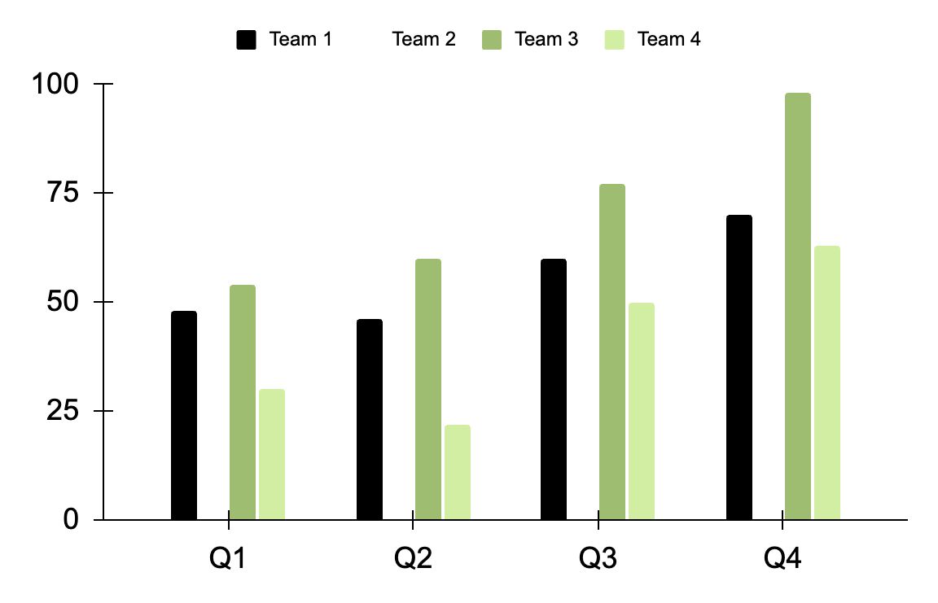
BAR GRAPH
TEAM 1
TEAM 2
TEAM 3
TEAM 4
Mars is very cold
Mercury is small
Venus is very hot
Earth has life
Follow the link in the graph to modify its data and then paste the new one here. For more info, click here

Slide 17
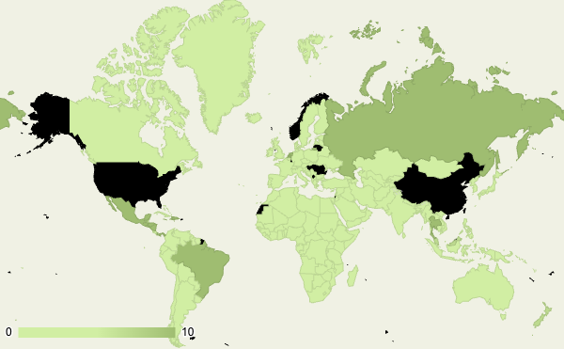
MAP
MARS
Mars is very cold
MERCURY
Mercury is small
VENUS
Venus is very hot
Follow the link in the graph to modify its data and then paste the new one here. For more info, click here

Slide 18
TABLE
 | TEAM A | TEAM B | TEAM C | TEAM D | TEAM E | TEAM F
Mercury | XX | XX | XX | XX | XX | XX
Mars | XX | XX | XX | XX | XX | XX
Saturn | XX | XX | XX | XX | XX | XX
Venus | XX | XX | XX | XX | XX | XX
Jupiter | XX | XX | XX | XX | XX | XX
Earth | XX | XX | XX | XX | XX | XX
Pluto | XX | XX | XX | XX | XX | XX

Slide 19
ORGANIZATIONAL CHART
The Sun
CEO
Jupiter
Manager I
Neptune
Manager II
Earth
Manager
The Moon
Employee
Mercury
Employee
Titan
Employee
Venus
Employee
Saturn
Employee

Slide 20
ROADMAP INFOGRAPHICS
INITIATIVE | OBJECTIVE | JAN | FEB | MAR | APR | MAY | JUN | JUL | AUG | SEP | OCT | NOV | DEC
Venus is very hot | Venus has a beautiful name and is the second planet from the Sun
Earth has life | Earth is the beautiful planet on which humans live
Mars is very cold | Despite being red, Mars is actually a cold planet
Jupiter is a gas giant | Jupiter is the biggest planet in the Solar System
Saturn has rings | Saturn is a gas giant and has several rings
Mercury is small | Mercury is the closest planet to the Sun and a very small object

Slide 21


PHOTO SHOWCASE
You can replace the images on the screen with others. Just right-click on any of them and select “Replace image”

Slide 22



ALTERNATIVE RESOURCES
Here’s an assortment of alternative resources whose style fits the one of this template:
Abstract creative background

Slide 23
RESOURCES
Did you like the resources in this template? Get them on these websites:
VECTORS
Geometric sales discount youtube banner
Geometric sales discount youtube cover
ICONS
Icon Pack: Work from Home | Filled
PHOTOS
Young people working together in a startup company
Front view of business woman smiling
Team working together on project
Medium shot employees working

